Slide 1
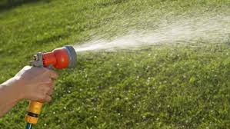
Accessing Water
Water scarcity in the world
7/8/2017

Slide 2
Review
What is SPICESS?
What is BOLTSS?
What is PERTIC?
Write them down and be prepared to share your answers.

Slide 3
Definitions
Water scarcity: when the demand for water is greater than the amount available
Water consumption: is the portion of water use that is not returned to the original water source after being withdrawn. It is no longer capable of reuse.

Slide 4
Definitions
Water use: describes the total amount of water withdrawn from its source to be used.
Water recycling: is wastewater that has been purified so it can be used again for new purposes

Slide 5

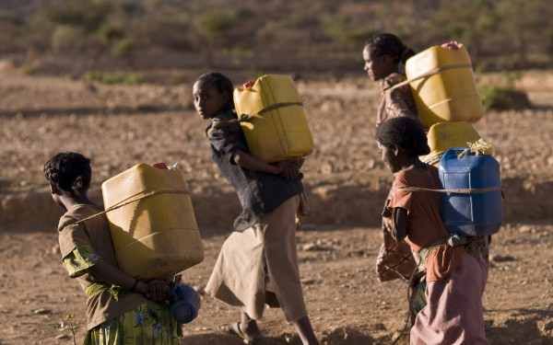
Why might these people place a higher value on water than you do?

Slide 6
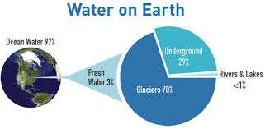
Source: http://gettingthepicture.info/3/

Slide 7
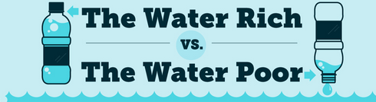
Water Rich - A country that usually has more available water than it needs for its population. They have access to water bodies such as large rivers and tend to have high rainfall.
Water Poor – A country that does not have enough water for its needs is considered water poor. These tend to be countries with drier climates that experience less rainfall.
Can we think of a country in the world that is water poor?

Slide 8
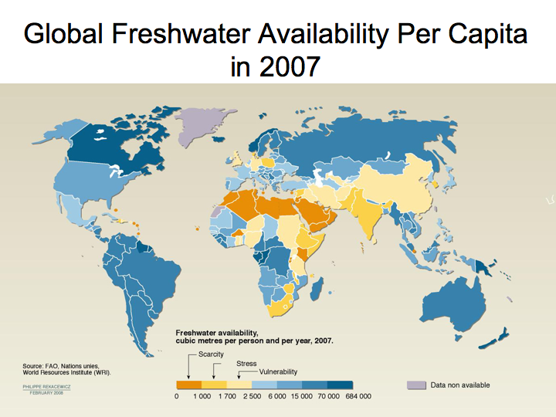

Slide 9
Water scarcity – pages 90-91
Questions:
What happens to drinking water in countries that have water scarcity (little water)?
How many countries in Africa experience water stress?
List the features of BOLTSS can you see on the world map on page 90?
Use an Atlas and the map of the world on page 90 to list the continents that are experiencing water scarcity or water stress.
True or false? Australia experiences water stress.

